Slide 1
Census Data Capstone Project
Charmayne Patterson

Slide 2
Explanation of the Problem
Throughout history, African Americans have faced numerous limitations and restrictions to their rights as Americans. The institution of slavery proved a crucial impediment to not only their freedom, but also their achievement. As a result of chattel slavery, African Americans were denied the most basic of rights and opportunities.
Historical myths would have us believe that the American north was synonymous with freedom and that once there, African Americans experienced full freedom and inclusion within American society. In fact, we know that life in the north presented its own challenges for African Americans and the lives they sought to create for themselves. I have attempted to use data science to better help capture and illustrate the conditions and characteristics of black life in the 19th century.

Slide 3
Project and Data Science
Census data from Philadelphia will provide the basis for our evaluation and prediction. In 1847, the United States had not yet confronted the institution of slavery or its consequences. At that point, almost 20 years before the start of the American Civil War, northern states of the relatively new republic had only recently freed those enslaved within their borders. Northern cities like Philadelphia, PA were regarded as havens for fugitive slaves and places were Blacks could live and actually experience freedom.
The data set helps us to gain insights into the lives of Black Philadelphians at the time. It includes census information concerning family size, the numbers of males and females residing in a household, their occupations, whether or not they were born in the state or not, whether or not they were born into slavery or not, and their ability to read and/or write.
The original data set consisted of 2851 observations of 11 variables.

Slide 4
Data Wrangling
The original data frame consisted of census data and consequently included numerous variables. I was able to utilize several data wrangling techniques to transform it into a document that can be easily analyzed. These techniques include removing unnecessary variables, changing “NA” to “0”, removing “NA” for numerical data, and changing the names of some columns.
Removing Unnecessary Variables: The original data frame included 46 variables. Many of these variables were not necessary for the classification study that I endeavor to undertake. Removing the variables reduced the data frame to 10 variables. Presently, all of the variables included should be relevant to the capstone project.

Slide 5
Data Wrangling cont’d
Changing “NA” to “0”, Removing “NA” for Numerical Data: In order to have the data more actively reflect the characteristics of the specific variables, I opted to change the “NA” assigned to several variables to “0”. This made the data more easily understandable as variables such as birthplace could more easily be identified, established. The designation of “NA” was also removed for all numerical data but was maintained for categorical data.
Changing Columns Names: Of the ten variables that are included in the data frame, several of them underwent a name change. When the data was imported into R Studio, some variables names were too long, and others did not accurately describe the particular data. Therefore, the names of the variables were changed to shorter, concise names that more accurately describe the data in the column.

Slide 6
Exploratory Analysis
While carrying out any analysis, it is always best to start off with a question. It is also important to know the metadata, or the data that describes the data. For example, we see the variable `Can.read` has values ranging from 0 to 5, but have no idea what these values mean. We may have assumed that this might be a binary value with 0 indicating the person cannot read and 1 indicating that the person can read. Or this could also mean the total number of people in a household who can read (which sounds more plausible to me). Either way, when looking at the metadata, we can observe the different values available in the `Can.read` and `Can.write` variables.

Slide 7
Exploratory Analysis cont’d
Looking at this, we are now more inclined to think that these two variables show us the number of people who can read or write in a family. So with these assumptions, what are the questions that come to mind? Personally I would really like to understand the impact of professions, gender and other variables available, on the level of education. For the 'level of education' we have two variables available, viz. `Can.read` and `Can.write`. we also know the size of a family. So perhaps it would be best to divide these two variables with the size of the family and look at this as a percentage to say what percent of a family is well versed with reading or writing. Prior to that we also want to check for discrepancies in the dataset. Given the family size, the sum of the Males and Females should be equal to the family size, considering this era only provided binary options for gender.

Slide 8
Exploratory Analysis cont’d
The remainder of the analysis focuses on education level, literacy, and occupations. The data frame (census_glm.csv) includes a variable labeled literate. If a family has above a 50% education level, then the family is literate. A (1) in the literate column specifies that a family is literate and a (0) means that the family is not literate.

Slide 9
Interesting Finds
The occupation with the largest number of males is porter. Since there are 1,426 different occupations, a filter is created to include only occupations that have at least 20 male family members. When viewing the occupations for females, it seems that more females seem to hold a position than males. This observation was fascinating to me as the male in modern times is viewed as the family provider. The most popular female position held is a washer.
Of the 14 chosen male occupations, families that have male porters have the highest illiteracy level. If a family has a male waiter, then the family is more likely to be literate. Females that hold a position washing and ironing have the least educated families. However, families that have female washers have higher family literacy levels.

Slide 10
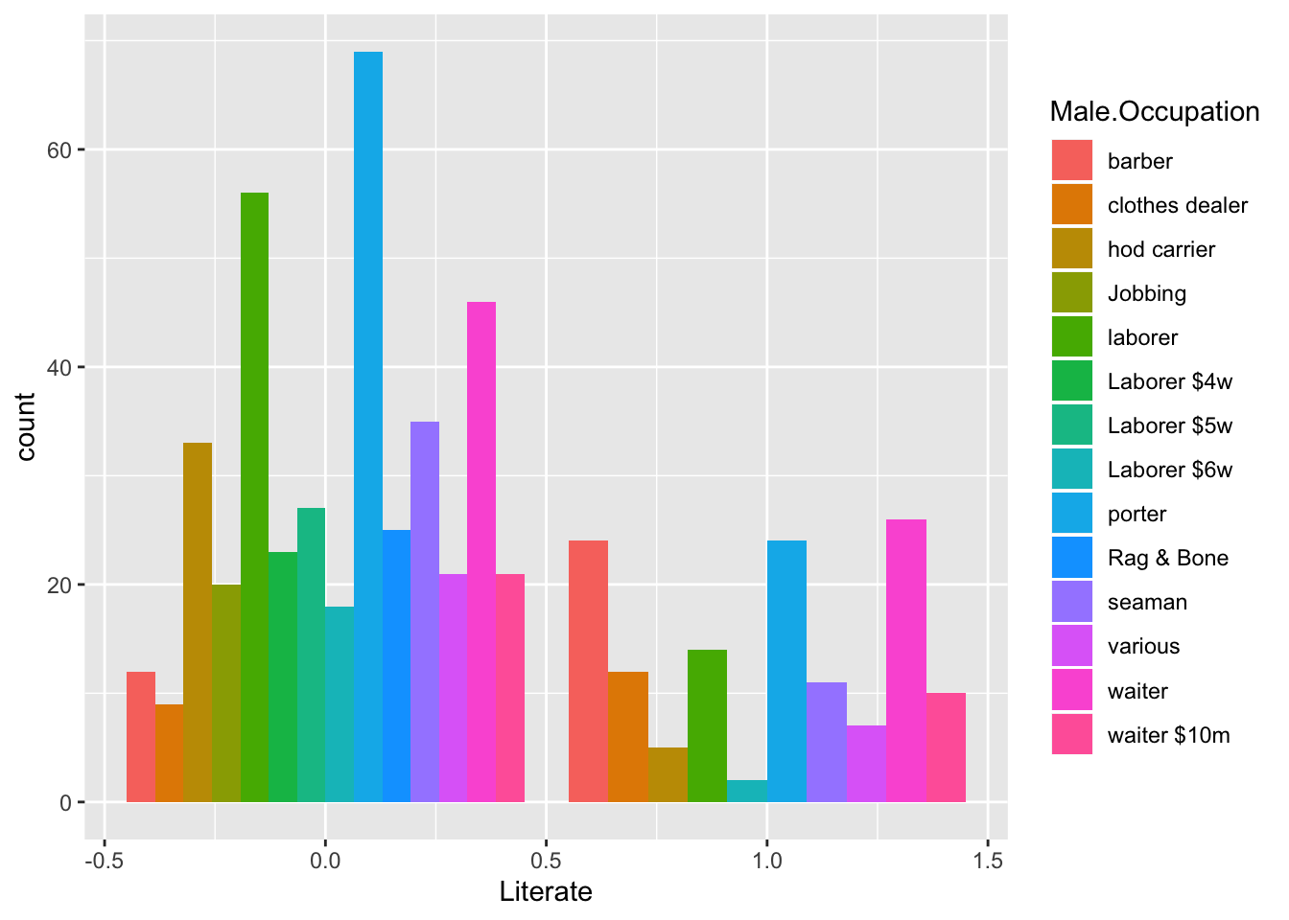

Slide 11
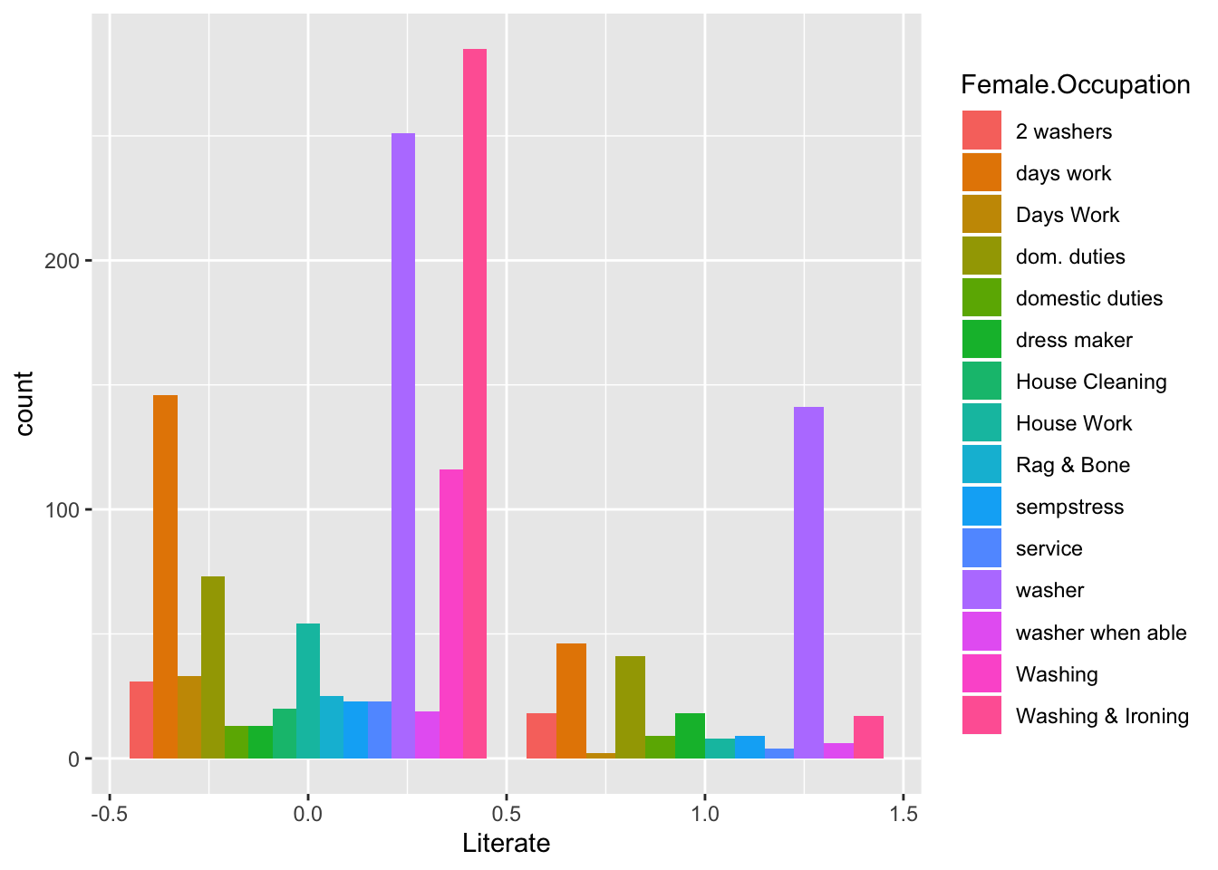

Slide 12
Machine Learning
In this section, we are only going to focus on the top five occupations for females and males as there are too many occupations and the model may not converge. The top means the occupations with the largest n. A new data frame with filters is created.
For the predictive part of this project, I'd like to predict if a family is literate given family size, male occupation, female occupation, and whether the family members were born slaves. Based on the variables of prediction, the problem is framed as a logistic regression whether a family is literate (1) or not(0). There are 27.3 families that are literate in the filtered data frame. This may cause problems when running a predictive model.
In creating creating the model, the independent variables for the model are family size, male occupation, female occupation, and whether the family members were born slaves. These variables are selected intuitively as variables that can give information regarding the dependent variable, literacy (literate).

Slide 13
Machine Learning cont’d
Prior to building the model lets split the dataset into two: training and test data. Typically a 80:20 split is what is used. So we will train our model on 80% and then test it on the remaining 20%.
It is interesting to note that repeatedly running the syntax for the testing and training sets returned various results for the test set and train set data frames. Thus, the code is present but is removed from the code chunk.

Slide 14
Results
Both models converged, we produced a summary for each model. In "model" the statistically significant variables are male occupation laborer, male occupation porter, born slaves, and family size. The variables that have any level of significance in "model_1" are male occupation carrier, male occupation laborer, male occupation porter, male occupation seaman, male occupation waiter, and family size. Included in the analysis are variables of any level of significance.
The results indicate that families containing a male with the occupation of carrier, laborer and porter are most likely to be literate. Also, smaller families are more likely to be literate.

Slide 15
Results cont’d
The overall results of the capstone project indicate that smaller families are more likely to be literate. They also suggest that male occupations are more likely to indicate a literate family than female occupations. Additionally (and most surprisingly) having a family member who was born a slave does not predict the literacy of these families.

Slide 16
Recommendations
Despite the fact that limitations in the census data presented challenges in identifying what variables would prove most impactful to literacy, this project served as a good starting point for identifying the ways in which census data can be used to make predictions about historical phenomena.

Slide 17
Considerations/Suggestions
This project provides a springboard to engage in similar data analysis for other cities and other eras. It would be interesting to determine, for example, how the census data from 1847 compares to Philadelphia census data from a later period, perhaps after the American Civil War. It would also be interesting to compare Philadelphia's data to that of other cities, such as Boston or New York City.

